Slide 1
URDU IMAGE CAPTION GENERATION USING DEEP LEARNING
Muhammad Osama Nusrat
21I-2169
MS-AI

Slide 2
INTRODUCTION
Image caption generation is outputting a correct and concise description of a given image.
Automated captioning of images demands an understanding of the fields of computer vision as well as Natural language processing.
Automated captioning is useful in situations where an image takes time to load or is unavailable.
These captions can also be used to classify the images.

Slide 3
MOTIVATION
The motivation for doing this project is that image captioning has been done in various languages such as English French etc. but it has not been done in Urdu despite of the fact Urdu is one of the most spoken languages in subcontinent.
This motivated me do this project.

Slide 4
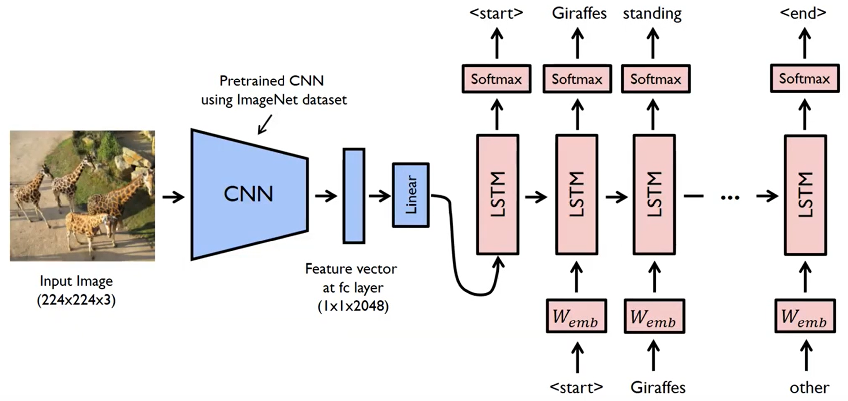
Image caption generation model

Slide 5
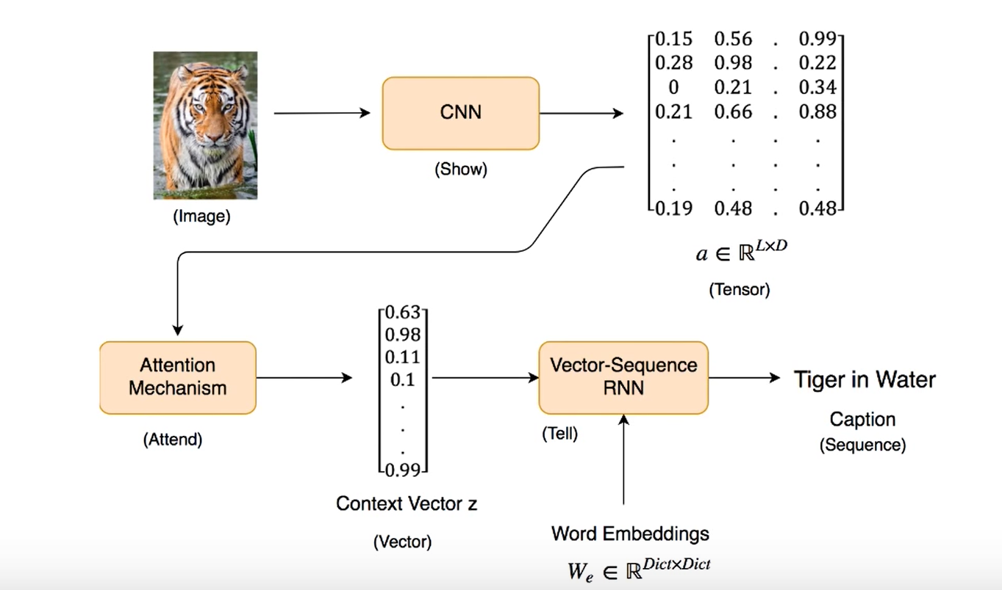
Image caption generation model

Slide 6
LITERATURE REVIEW

Slide 7
Image Captioning with Deep Bidirectional LSTMs
A pre-trained 16 layer vggnet convolutional neural network for feature extraction of the input image,
Bidirectional long short-term memory (LSTM) networks are used as a decoder for generating captions for the input image.
Three datasets which are Flickr8k, Flickr30k, and MSCOCO are used.
Each image in the dataset is pre-annotated with 5 captions.
BLEU was used as an evaluation metric for performance.
The model showed the best results on the MS COCO dataset due to the greater no of training images

Slide 8
Image Caption Generation Using Deep Learning Technique
Pretrained models of VGG 16 and Vgg 19 are used as encoders for extracting features from the input images.
LSTM is used as a decoder for generating captions of the images.
3 data sets are used which are Flickr8k, Flickr30k, and MSCOCO datasets respectively.
BLEU gave highest score on the MSCOCO dataset which was 0.67257.

Slide 9
The role of attention mechanism and multi-feature in image captioning
Vgg16 is used for feature extraction and LSTM for decoding the feature vector.
Flickr 8k and Flickr 30k dataset were used.
Attention model is used.
BLEU was used as a metric to evaluate the performance of model which uses attention and which does not use attention.
The model which used attention gave better BLEU score as compared to
model which does not used attention.

Slide 10
Deep learning based automatic image caption generation
Inception V3 is used as an encoder. And GRU as a decoder.
Attention model is added to capture only the relevant details in image.
MSCOCO dataset is used.
As dataset is large so GRU is not good for generating captions.

Slide 11
Image Caption Generator Using Attention Mechanism
Inception V3 as a CNN for feature extraction and GRU as a decoder.
MS-Coco dataset is used.
Use of attention model to capture only the relevant details in the image.
GRU is used because training images are less .

Slide 12
Efficient Urdu Caption Generation using Attention based LSTM
Only paper which have done some work in generating urdu captions.
Flickr 8k dataset used and 700 images were manually annotated in urdu with each image having 5 captions respectively.
Resnet-101 was used for feature extraction and GRU for generating captions.
Vocabulary of urdu words was less due to less no of images.
Some of the captions generated were not relevant to the images.

Slide 13
Literature Summary
Author | Encoder | Decoder | Dataset | Attention used | Strength | Weakness/ Improvement
Wang etal | Vgg16 | Bi-LSTM | Flickr8k,30k, MS-Coco | No | Use of bidirectional RNN | Use of better CNN architecture
Jabade etal | Vgg19 | LSTM | Flickr8k,30k, MS-Coco | No | Vanishing gradient issue discarded due to LSTM | Use of better CNN architecture
Kim etal | Vgg16 | LSTM | Flickr8k,30k | Yes | Use of attention model | Nil

Slide 14
Author | Encoder | Decoder | Dataset | Attention used | Strength | Weakness/Improvement
Kolhekar etal | Incetion+Resnet | GRU | MS-Coco | No | Use of Inception V2 | Gru not good for large dataset
Agarwal etal | Inception V3 | GRU | MS-Coco | Yes | Use of attention model | Less images used for training
Ilahi etal | Resnet-101 | GRU | Flickr8k | Yes | Use of GRU because dataset is small | Better results Big dataset

Slide 15
Research Problem
The automatic generation of captions of images is an important problem in the domain of AI.
The problem statement is to generate caption of images in Urdu using deep learning and Nlp using the Flickr 8k dataset. 1500 images will be taken from 8k images and each image will be manually annotated in Urdu 5 times.

Slide 16
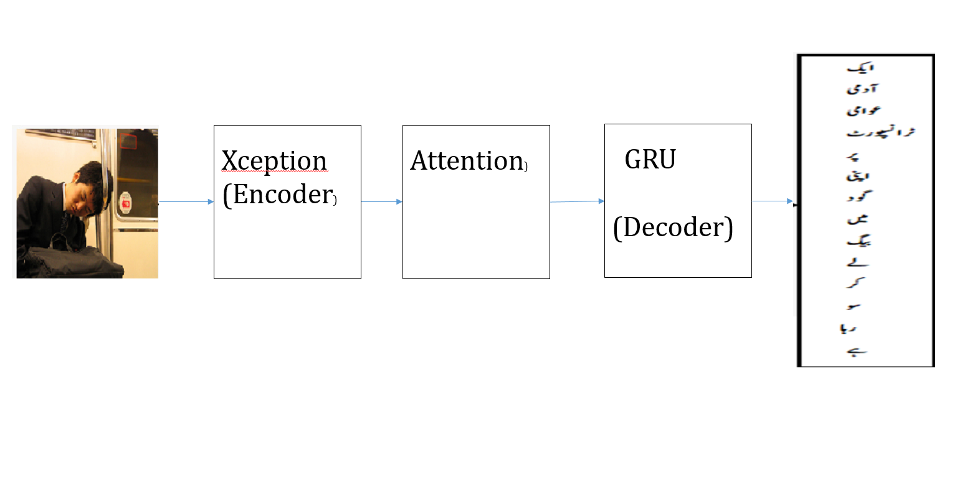
Proposed Approach
Proposed Image caption generator

Slide 17
XCEPTION
It is improved version of inception v3.
It uses depth wise separable convolution with a slight change.
Point wise convolution followed by depth wise convolution.
Xception CNN model outperforms Resnet-101, inceptionv3 on imagenet dataset wth better accuracy.

Slide 18
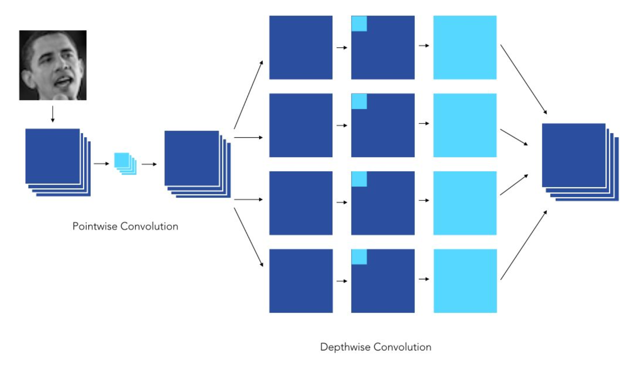
Xception architecture

Slide 19
DATASET
I will use Flickr 8k dataset.
1500 images will be taken and manually annotated in urdu.
Generate vocabulary of Urdu words which are used in captions.

Slide 20
Conclusion
In this paper, we have proposed an Urdu image caption generator with Xception as CNN and GRU as decoder which will aid in generating captions.
Lots of work has been done in image captioning but in Urdu language there is a lot of gap and work needs to be done in this language also.
We used the flickr8k dataset and took 1500 images from it and manually annotated them. Xception was used because it gives good results than other CNN such Vggnet , Resnet and inceptionv3.
In future we can extend this work by using a bigger dataset and we can also do some work on Urdu grammar which can help in improving the results.

Slide 21
REFERENCES
Wang, C., Yang, H., Bartz, C., & Meinel, C. (2016, October). Image captioning with deep bidirectional LSTMs. In Proceedings of the 24th ACM international conference on Multimedia (pp. 988-997).
Amritkar, C., & Jabade, V. (2018, August). Image caption generation using deep learning technique. In 2018 fourth international conference on computing communication control and automation (ICCUBEA) (pp. 1-4). IEEE.
Dang, T. X., Oh, A., Na, I. S., & Kim, S. H. (2019, January). The role of attention mechanism and multi-feature in image captioning. In Proceedings of the 3rd International Conference on Machine Learning and Soft Computing (pp. 170-174).

Slide 22
Kesavan, V., Muley, V., & Kolhekar, M. (2019, October). Deep learning based automatic image caption generation. In 2019 Global Conference for Advancement in Technology (GCAT) (pp. 1-6). IEEE.
Agrawal, V., Dhekane, S., Tuniya, N., & Vyas, V. (2021, July). Image Caption Generator Using Attention Mechanism. In 2021 12th International Conference on Computing Communication and Networking Technologies (ICCCNT) (pp. 1-6). IEEE.
Ilahi, I., Zia, H. M. A., Ahsan, M. A., Tabassam, R., & Ahmed, A. (2020). Efficient Urdu Caption Generation using Attention based LSTM. arXiv preprint arXiv:2008.01663.

Slide 23
Questions?

Slide 24
Thank you!

